Slide 1
Chapter 6: Feistel Networks

Slide 2
Key Schedule
In addition to the cipher key, all block ciphers have a second algorithm called a key schedule. The key schedule derives a unique key from the cipher, called a round key, for each round of the cipher.
Using a key schedule, each round uses a key that is slightly different from the key used in the previous round. Because both the sender (who encrypts the message) and the receiver (who must decrypt the message) are using the same cipher key as a starting point and are using the same key schedule, they will generate the same round keys.

Slide 3
Feistel History
Feistel is used in DES, CAST-128, Blowfish, Twofish, RC5, and others.
First seen in IBM’s Lucifer algorithm (the precursor to DES).
Michael Luby and Charles Rackoff analyzed the Feistel cipher construction and proved that if the round function is a cryptographically secure pseudorandom function, then three rounds is sufficient to make the block cipher a pseudorandom permutation, while four rounds is sufficient to make it a “strong” pseudorandom permutation.

Slide 4
The Feistel Function
This function is named after its inventor, the German-born physicist and cryptographer Horst Feistel.
At the heart of many block ciphers is a Feistel function, which forms the basis for most block ciphers. This makes it one of the most influential developments in symmetric block ciphers. It is also known as a Feistel Network or a Feistel cipher.

Slide 5
The Feistel Function
This function starts by splitting the block of plain text data (often 64 bits) into two parts (traditionally termed L₀ and R₀).
The round function F is applied to one of the halves. (A round function is performed with each iteration, or round, of the Feistel cipher.) The details of the round function F can vary with different implementations. Usually these are simple functions to allow for increased speed of the algorithm.
The output of each round function F is then XOR’d with the other half. For example, you can pass L₀ through the round function F, and then take the result and XOR it with R₀.
Then the halves are transposed. So L₀ gets moved to the right and R₀ gets moved to the left.
This process is repeated a given number of times. The main differences between cryptography algorithms is the exact nature of the round function F and the number of iterations.

Slide 6
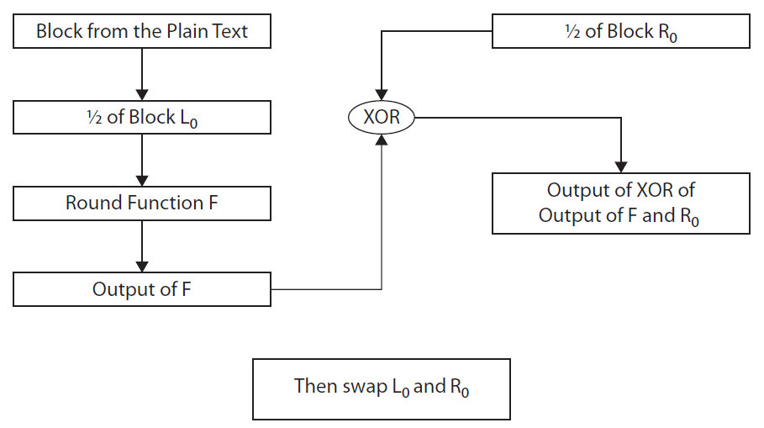
The Feistel Function
Here is a general overview of a basic round of a Feistel cipher:

Slide 7
Unbalanced Feistel
A variation of the Feistel network is called an Unbalanced Feistel cipher.
These ciphers use a modified structure, where L₀ and R₀ are not of equal lengths. This means that L₀ might be 32 bits and R₀ could be 64 bits (making a 96-bit block of text). This variation is used in the Skipjack algorithm.

Slide 8
Skipjack
This is an example of an unbalanced Feistel cipher. It was developed by the NSA and was designed for the clipper chip. It was originally classified.
The clipper chip has built-in encryption, but the decryption key is kept in a key escrow in case law enforcement needs to decrypt data without the computer owner’s cooperation. This made the process highly controversial.
Skipjack uses an 80-bit key to encrypt or decrypt 64-bit data blocks. It is an unbalanced Feistel network with 32 rounds.

Slide 9
Pseudo-Hadamard Transform
This technique is applied in several symmetric ciphers, so it is important to be familiar with it. Fortunately it is rather simple to understand.
A pseudo-Hadamard transform (PHT) is a transformation of a bit string that is designed to produce diffusion in the bit string. The bit string must be of even length because it is split into two equal halves.
So, for example, a 64-bit string is divided into two 32-bit halves. To compute the transform of a, you add a + b (mod 2^{n}). To compute the transform of b, you add a + 2b (mod 2^{n}). The n is the number of bits of each half, in our example 32.

Slide 10
MDS Matrix
An MDS Matrix (Maximum Distance Separable) represents a function. It is used in cryptography to accomplish diffusion. It is used in several cryptographic algorithms, including Twofish.
Here’s a basic definition of the MDS matrix:
  An m × n matrix over a finite field is an MDS matrix if it is the transformation matrix of a linear transformation.
This is a greatly simplified definition. It is, however, adequate for you to understand how algorithms like Twofish are designed.

Slide 11
Lucifer
The Lucifer cipher was the first incarnation of a Feistel cipher. There were variations, perhaps the most widely known used a 128-bit cipher key and operated on 128-bit blocks.
The original description by Horst Feistel had a 48-bit cipher key applied to a 48-bit block. Yet another variant used a 64-bit cipher key on a 32-bit block.
Regardless of the key or block size, Lucifer operated exactly like the Feistel cipher. The 128-bit block of plain text is separated into two 64-bit blocks (L and R).

Slide 12
DES
The Data Encryption Standard is a classic in the annals of cryptography. It was selected by the National Bureau of Standards as an official Federal Information Processing Standard (FIPS) for the United States in 1976.
While it is now considered outdated and is not recommended for use, it was the premier block cipher for many. The primary reason it is no longer considered secure is its small key size. The algorithm itself is quite sound.
Many cryptography textbooks and university courses use DES as the basic template for studying all block ciphers. We will do the same.

Slide 13
DES
Key Schedule
To generate the round keys, the 56-bit key is split into two 28-bit halves, and those halves are circularly shifted after each round by one or two bits. This will provide a different sub key each round.
During the round key generation portion of the algorithm (the key schedule), in each round, the two halves of the original cipher key (the 56 bits of key the two endpoints of encryption must exchange) are shifted a specific amount.

Slide 14
DES
Once the round key has been generated for the current round, the next step is to address the half of the original block that will be input into the round function.
Recall that the two halves are each 32 bits. The round key is 48 bits. That means that the round key does not match the size of the half block it is going to be applied to.
You cannot really XOR a 48-bit round key with a 32-bit half block, unless you simply ignore 16 bits of the round key. If you did so, you would basically be making the round key effectively shorter and thus less secure, so this is not a good option. The 32-bit half needs to be expanded to 48 bits before it is XOR’d with the round key.

Slide 15
DES
This is accomplished by replicating some bits so that the 32-bit half becomes 48 bits.
This expansion process is quite simple. The 32-bit half to be expanded is divided into 4-bit sections. The bits on each end are duplicated. If you divide 32 by 4 the answer is 8. So there are 8 of these 4-bit groupings. If you duplicate the end bits of each grouping, that will add 16 bits to the original 32, thus providing a total of 48 bits.

Slide 16
DES
The resultant 48-bit string is XOR’d with the 48-bit round key. That is the extent of the round key being used in each round. It is now dispensed with, and on the next round another 48-bit round key will be derived from the two 28-bit halves of the 56-bit cipher key.
Now we have the 48-bit output of the XOR operation. That is now split into eight sections of 6 bits each. For the rest of this explanation, we will focus on just one of those 6-bit sections, but keep in mind that the same process is done to all eight sections.

Slide 17
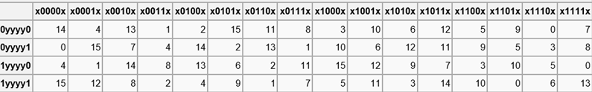
DES
The 6-bit section is used as the input to an S-box. An S-box is a table that takes input and produces an output based on that input. In other words. it is a substitution box that substitutes new values for the input.
The S-boxes used in DES are published, and the first is shown here:

Slide 18
DES
At the end of this, you have produced 32 bits that are the output of the round function.
Then in keeping with the Feistel structure, they get XOR’d with the 32 bits that were not input into the round function, and the two halves are swapped.
DES is a 16-round Feistel cipher, meaning this process is repeated 16 times.

Slide 19
3DES
Eventually it became obvious that DES would no longer be secure. The U.S. government began a contest seeking a replacement cryptography algorithm. In the meantime, 3DES was created as an interim solution. Essentially it does DES three times, with three different keys.
Triple DES uses a “key bundle” that comprises three DES keys: K1, K2, and K3. Each key is standard 56-bit DES key. There were some variations that would use the same key for K1 and K3, but three separate keys is considered the most secure.

Slide 20
GOST
GOST is a DES-like algorithm developed by the Soviets in the 1970s. It was classified but was released to the public in 1994. It uses a 64-bit block and a key of 256 bits. It is a 32-round Feistel cipher.
GOST is an acronym for gosudarstvennyy standart, which translates into English as “state standard.”
The official designation is GOST 28147-89. It was meant as an alternative to the U.S. DES algorithm and has some similarities to DES.

Slide 21
Blowfish
Blowfish is a symmetric block cipher.
This algorithm was published in 1993 by Bruce Schneier. This cryptography algorithm was intended as a replacement for DES.
Like DES, it is a 16-round Feistel cipher working on 64-bit blocks. However, unlike DES, it can have varying key sizes ranging from 32 bits to 448 bits.
Early in the cipher, the cipher key is expanded. Key expansion converts a key of at most 448 bits into several sub key arrays totaling 4168 bytes.

Slide 22
Twofish
Twofish was one of the five finalists of the AES contest (which is explored in more detail in Chapter 7).
It is related to the block cipher Blowfish, and Schneier was also part of the team that worked on this algorithm.
Twofish is a Feistel cipher that uses a 128-bit block size and key sizes of 128, 192, and 256 bits. It also has 16 rounds, like DES.
Like Blowfish, Twofish is not patented and is in the public domain. It can be used without restrictions by anyone.

Slide 23
CAST
There are two well-known versions of CAST: CAST-128 and CAST-256.
CAST-256 was a candidate in the AES contest and is based on the earlier CAST-128. CAST-128 is used in some versions of PGP (Pretty Good Privacy). The algorithm was created by Carlisle Adams and Stafford Tavares.
CAST-128 can use either 12 or 16 rounds, working on a 64-bit block. The key sizes are in 8-bit increments, ranging from 40 bits to 128 bits, but only in 8-bit increments. The 12-round version of CAST-128 is used with key sizes less than 80 bits, and the 16-round version is used with key sizes of 80 bits or longer.
CAST-128 has eight S-boxes, each 32 bits in size.

Slide 24
FEAL
FEAL (Fast data Encipherment Algorithm) was designed by Akihrio Shimizu and Shoji Miyaguchi and published in 1987.
There are variations of the FEAL cipher, but all use a 64-bit block and essentially the same round function. FEAL-4 uses four rounds, FEAL-8 uses eight rounds, FEAL-N uses N rounds, chosen by the implementer.
This algorithm has not done well under cryptanalysis. Several weaknesses have been found in the algorithm and it is not considered secure.

Slide 25
MARS
MARS was IBM’s submission to the AES contest and became one of the final five finalists, though it was ultimately not selected.

Slide 26
TEA
TEA, or Tiny Encryption Algorithm, was created by David Wheeler and Roger Needham and first publically presented in 1994.
It is a simple algorithm, easy to implement in code.
It is a Feistel cipher that uses 64 rounds (note this is a suggestion; it can be implemented with fewer or more rounds).

Slide 27
LOKI97
LOKI97 was a candidate in the AES contest but was not chosen.
The algorithm was developed by Lawrie Brown. There have been other incarnations of the LOKI cipher, namely LOKI89 and LOKI91. The earlier versions used a 64-bit block.

Slide 28
Camellia
Camellia is a Japanese cipher that uses a block size of 128 bits and key sizes of 128, 192, or 256 bits (like AES). With a 128-bit key, Camellia uses 18 rounds, but with the 192- or 256-bit key, it uses 24 rounds.
Some browsers, such as Google Chrome, prefer to use Camellia for encryption. They will attempt to negotiate with the server, and if the server can support Camellia, the browser will select it over AES.

Slide 29
ICE
ICE, or Information Concealment Engine, was developed in 1997.
It is similar to DES but uses a bit permutation during its round function that is key dependent.
ICE works with 64-bit blocks using a 64-bit key and 16 rounds. The algorithm is in the public domain and not patented. A faster variant of ICE, Thin-ICE, uses only 8 rounds.

Slide 30
Simon
Simon is a group of block ciphers. What makes it interesting is that it was released by the NSA in 2013.
It has many variations. For example, one variation uses 32-bit blocks with a 64-bit key and 32 rounds. However, if you use a 64-bit block, you can choose between 96- and 128-bit keys and either 42 or 44 rounds.
The largest block size, 128 bits, can use key sizes of 128 bits, 192 bits, or 256 bits with either 68, 69, or 72 rounds.

Slide 31
Electronic Codebook (ECB)
The most basic encryption mode is the electronic codebook (ECB) mode.
The message is divided into blocks and each block is encrypted separately.
However, if you submit the same plain text more than once, you always get the same cipher text. This gives attackers a place to begin analyzing the cipher to attempt to derive the key.

Slide 32
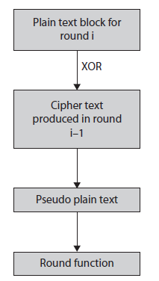
Cipher-Block Chaining (CBC)
When using cipher-block chaining (CBC) mode, each block of plain text is XOR’d with the previous cipher text block before being encrypted.
This means there is significantly more randomness in the final cipher text.
This is much more secure than electronic codebook mode and is the most common mode.

Slide 33
Propagating Cipher-Block Chaining (PCBC)
The propagating cipher-block chaining mode was designed to cause small changes in the cipher text to propagate indefinitely when decrypting and encrypting.
This method is sometimes called plain text cipher-block chaining.
The PCBC mode is a variation on the CBC mode of operation. It is important to keep in mind that the PCBC mode of encryption has not been formally published as a federal standard.

Slide 34
Cipher Feedback (CFB)
In CFB mode, the previous cipher text block is encrypted. Then the cipher text produced is XOR’d back with the plain text to produce the current cipher text block.
Essentially it loops back on itself, increasing the randomness of the resultant cipher text.

